Slide 1
Ai Biologist LLM data extraction to database for lab automation

Slide 2
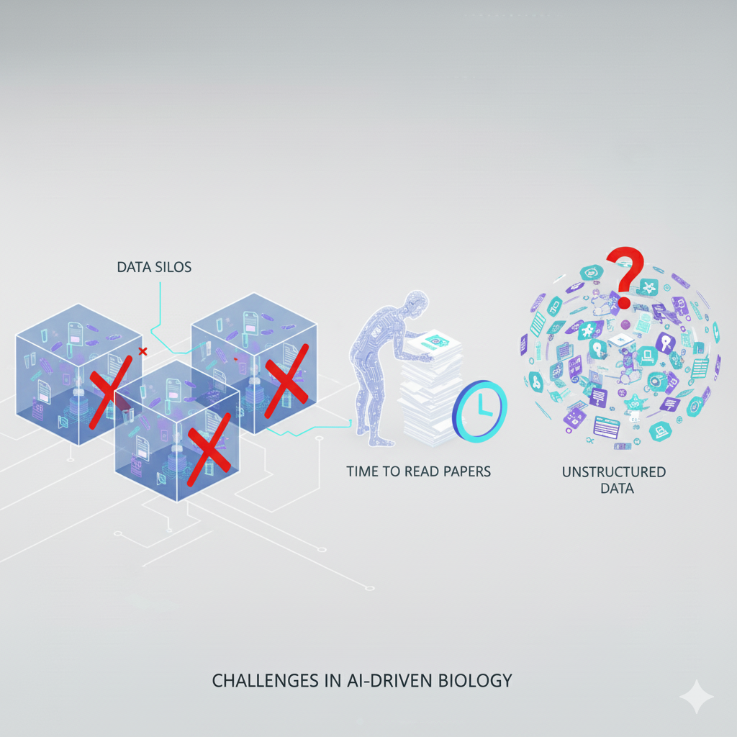
Problem
Data Silos
Reading Papers
Unstructured Data

Slide 3
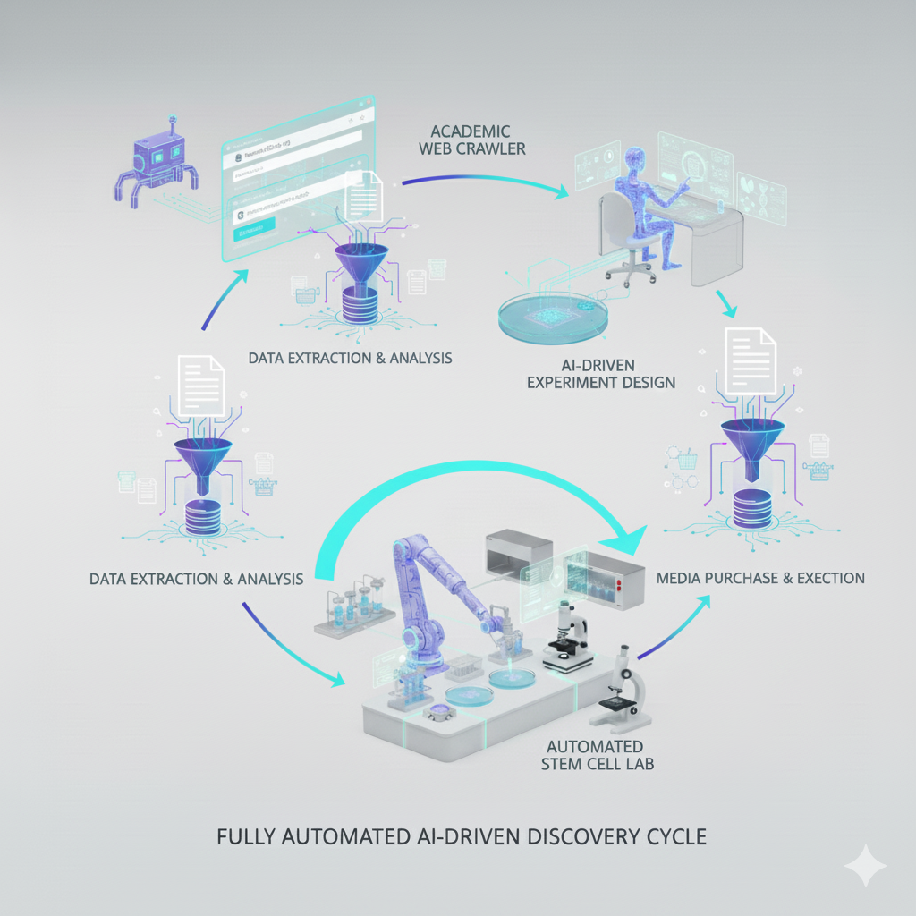
Automated Stem Cell Lab
Crawl Web
Extract Data
Structure Data
Design Experiments
Execute Experiments
Recursive Learning

Slide 4
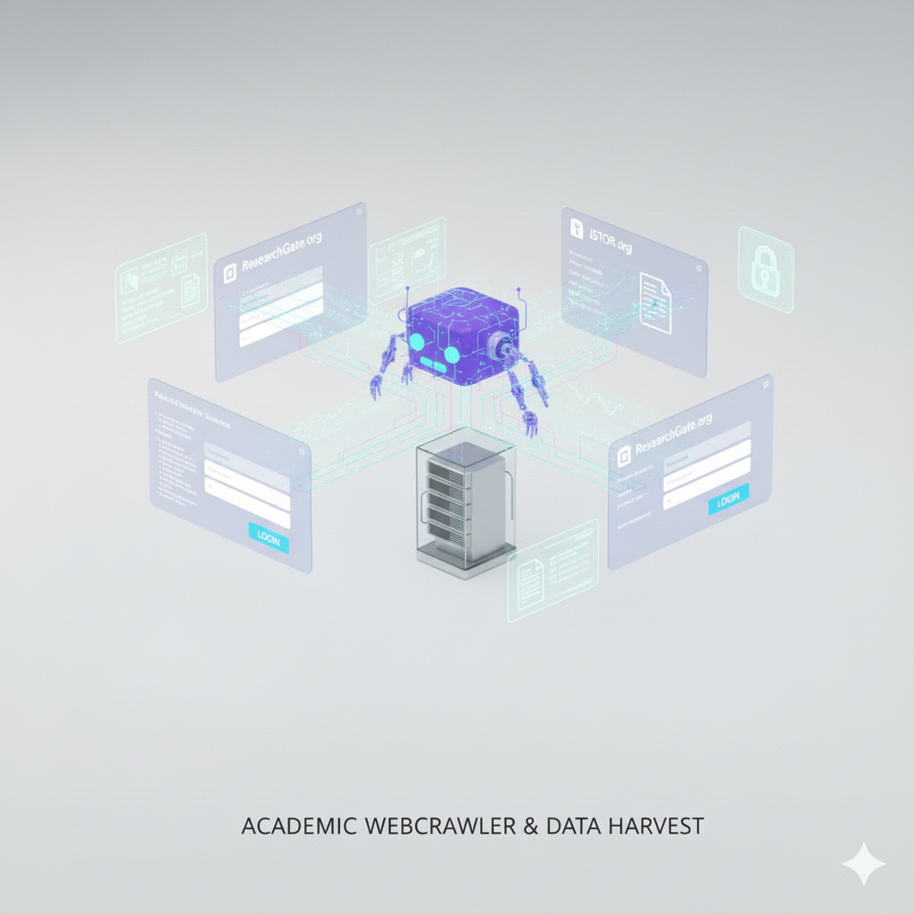
Web Crawler

Slide 5

Extract Data

Slide 6
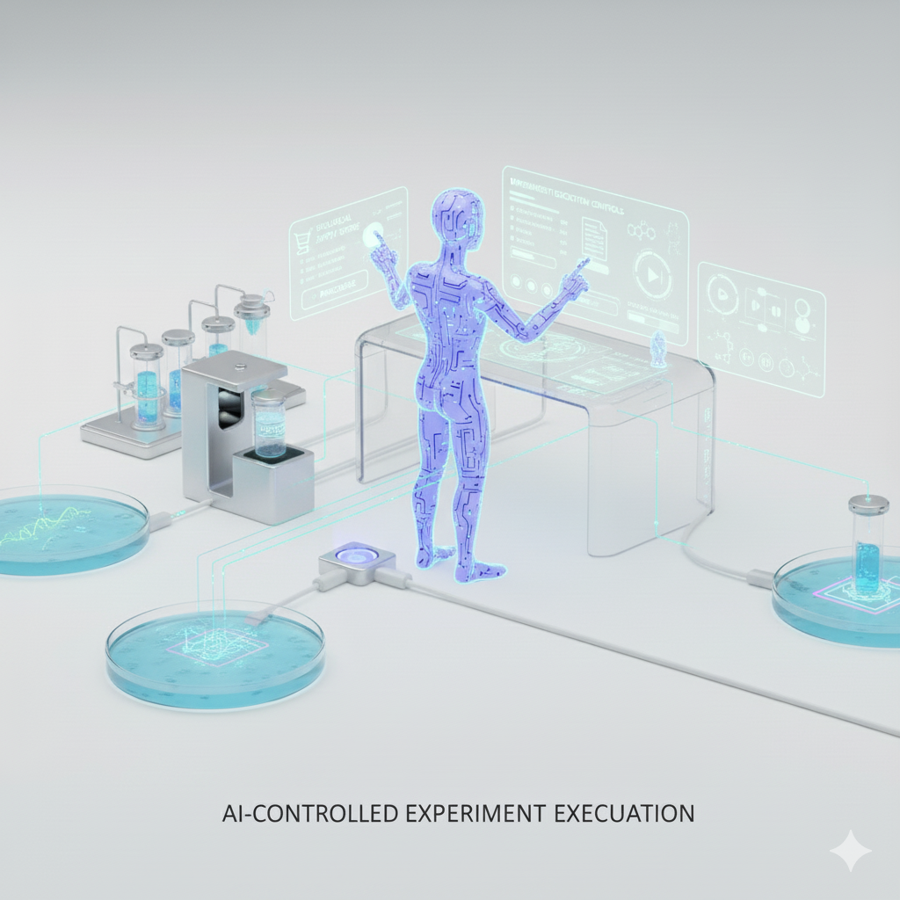
AI Experimental Design

Slide 7
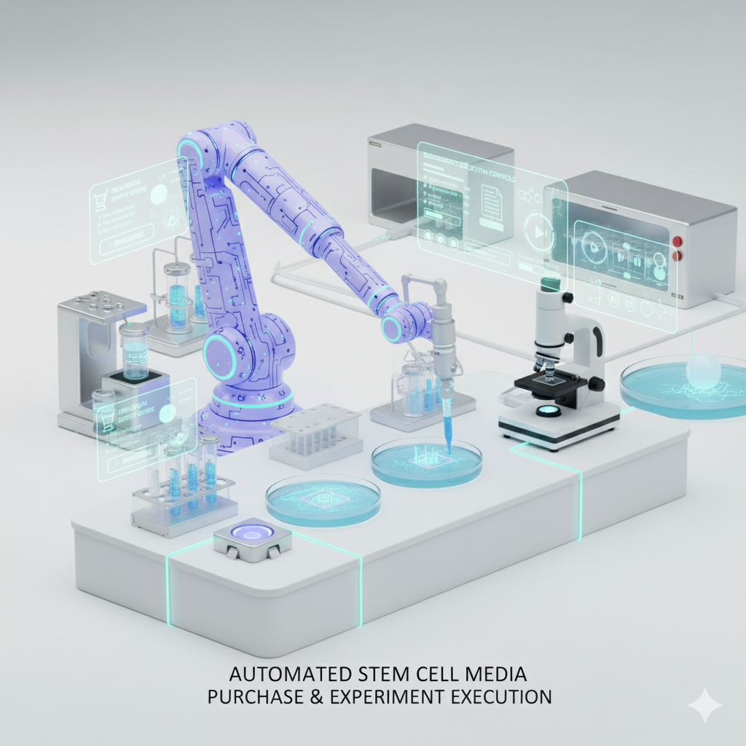
Execute Experiment

Slide 8
Recursive Learning

Slide 9
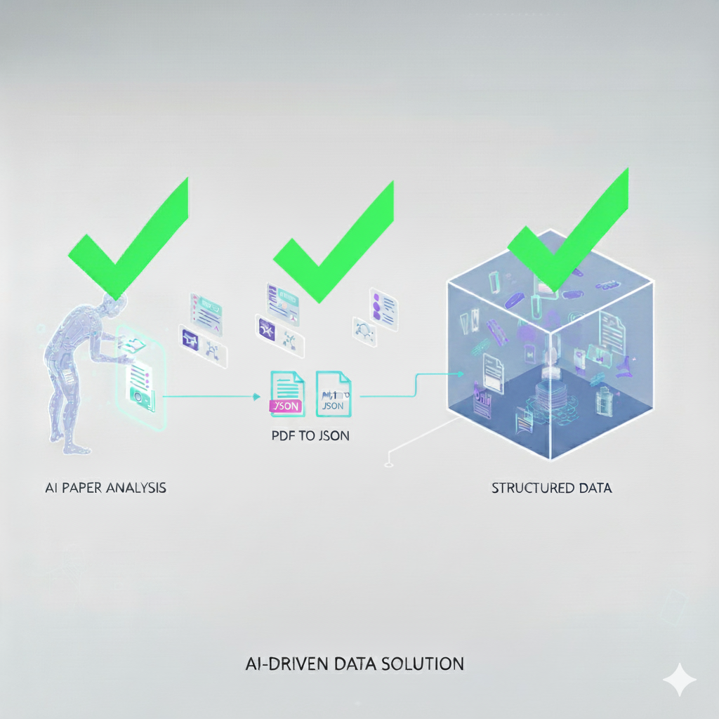
Extract Data
AI Paper Analysis
PDF to text
Structure DATA
Meta Data
Results
Methods

Slide 10
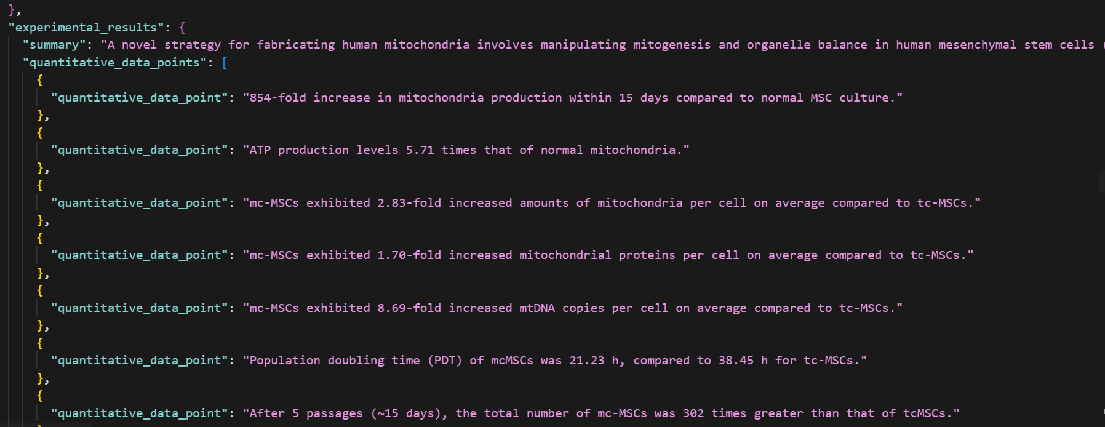

Slide 11
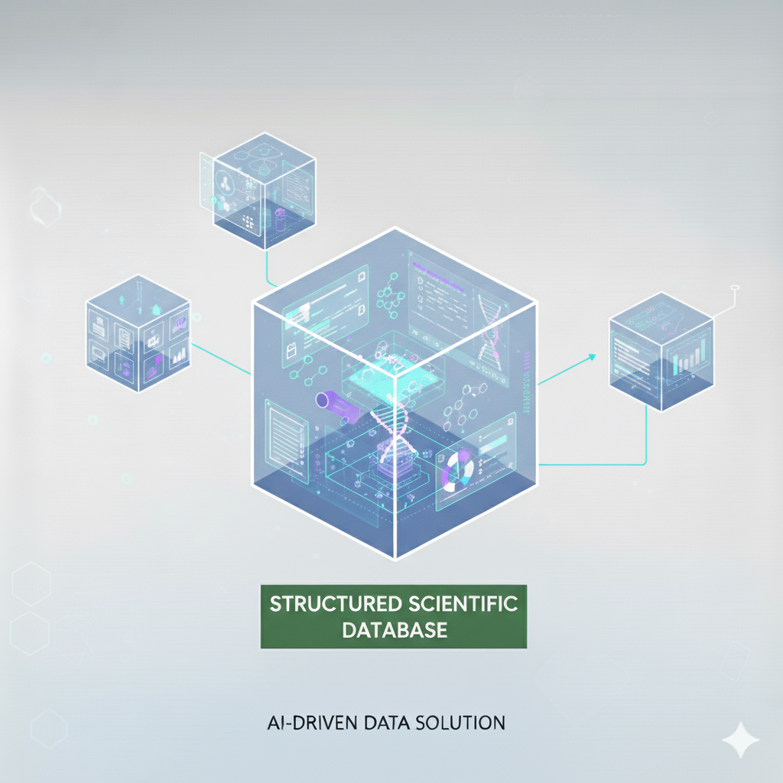
Structure Data

Slide 12
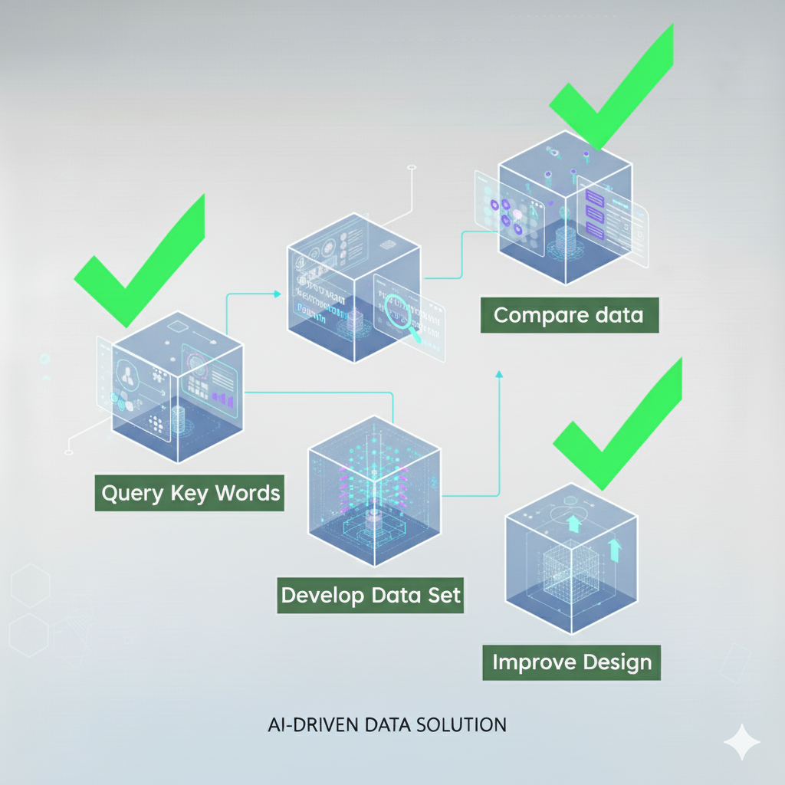
Query Data
Compare data
Query Key Words
Develop Data Set
Improve Design

Slide 13
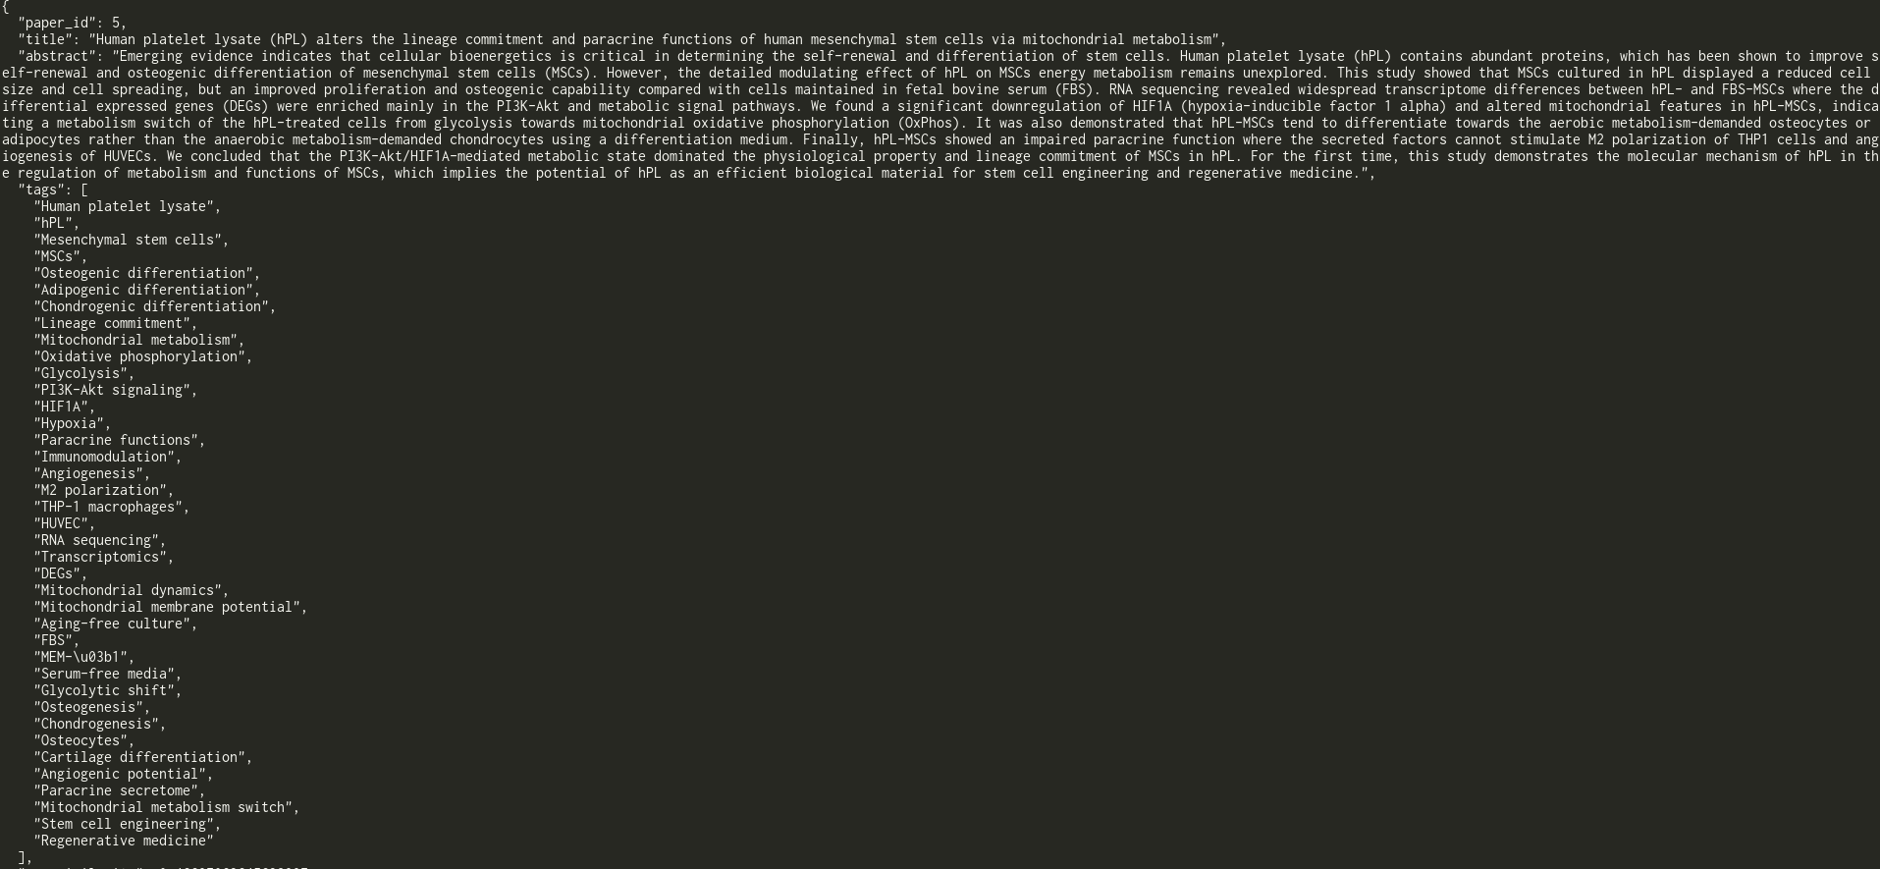

Slide 14
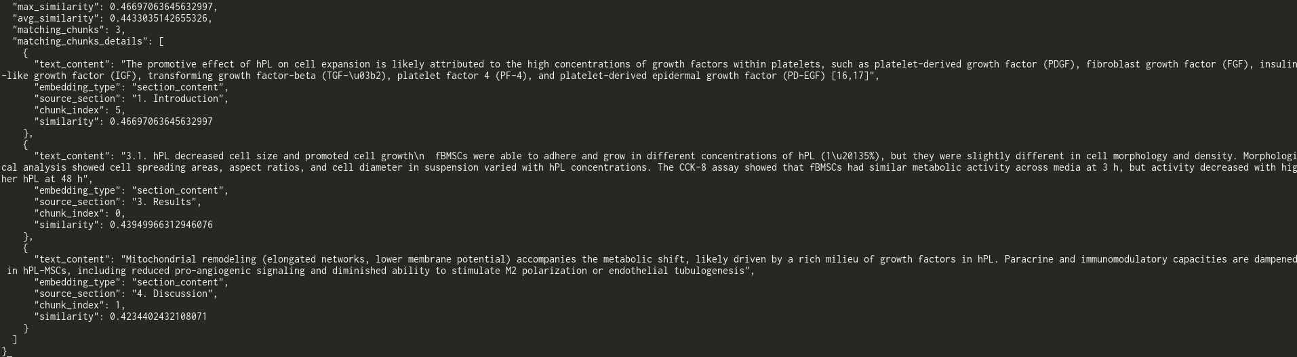

Slide 15
Use Cases
Compare data

Slide 16
Engaging the audience
Techniques for connecting
Make eye contact with your audience to create a sense of intimacy and involvement
Weave relatable stories into your presentation using narratives that make your message memorable and impactful
Encourage questions and provide thoughtful responses to enhance audience participation
Use live polls or surveys to gather audience opinions, promoting engagement and making sure the audience feel involved

Slide 17
Selecting Visual Aids

Slide 18
Effective delivery techniques
Voice modulation
Body language
This is a powerful tool in public speaking. It involves varying pitch, tone, and volume to convey emotion, emphasize points, and maintain interest:
Pitch variation
Tone inflection
Volume control
Effective body language enhances your message, making it more impactful and memorable:
Meaningful eye contact
Purposeful gestures
Maintain good posture
Control your expressions

Slide 19
Navigating Q&A Sessions
Preparing for questions
Maintaining composure
Know your material in advance
Anticipate common questions
Rehearse your responses
Maintaining composure during the Q&A session is essential for projecting confidence and authority. Consider the following tips for staying composed:
Stay calm
Actively listen
Pause and reflect
Maintain eye contact

Slide 20

Speaking Impact
Your ability to communicate effectively will leave a lasting impact on your audience
Effectively communicating involves not only delivering a message but also resonating with the experiences, values, and emotions of those listening

Slide 21
Dynamic delivery
METRIC | MEASUREMENT | TARGET | ACTUAL
Audience attendance | # of attendees | 150 | 120
Engagement duration | Minutes | 60 | 75
Q&A interaction | # of questions | 10 | 15
Positive feedback | Percentage (%) | 90 | 95
Rate of information retention | Percentage (%) | 80 | 85
Learn to infuse energy into your delivery to leave a lasting impression
One of the goals of effective communication is to motivate your audience

Slide 22
Final tips & takeaways
Practice makes perfect
Continue improving
Consistent rehearsal
Strengthen your familiarity
Refine delivery style
Pacing, tone, and emphasis
Timing and transitions
Aim for seamless, professional delivery
Practice audience
Enlist colleagues to listen & provide feedback
Seek feedback
Reflect on performance
Explore new techniques
Set personal goals
Iterate and adapt

Slide 23
Speaking engagement metrics
IMPACT FACTOR | MEASUREMENT | TARGET | ACHIEVED
Audience interaction | Percentage (%) | 85 | 88
Knowledge retention | Percentage (%) | 75 | 80
Post-presentation surveys | Average rating | 4.2 | 4.5
Referral rate | Percentage (%) | 10 | 12
Collaboration opportunities | # of opportunities | 8 | 10

Slide 24
THANK YOU
Brita Tamm
502-555-0152
brita@firstupconsultants.com
www.firstupconsultants.com

